Slide 1
The Process Abstraction

Slide 2
OS provides process abstraction
When you run an exe file, the OS creates a process = a running program
OS timeshares CPU across multiple processes: virtualizes CPU
OS has a CPU scheduler that picks one of the many active processes to execute on a CPU
Policy: which process to run
Mechanism: how to “context switch” between processes

Slide 3
What constitutes a process?
A unique identifier (PID)
Memory image
Code & data (static)
Stack and heap (dynamic)
CPU context: registers
Program counter
Current operands
Stack pointer
File descriptors
Pointers to open files and devices

Slide 4
How does OS create a process?
Allocates memory and creates memory image
Loads code, data from disk exe
Creates runtime stack, heap
Opens basic files
STD IN, OUT, ERR
Initializes CPU registers
PC points to first instruction

Slide 5
States of a process
Running: currently executing on CPU
Ready: waiting to be scheduled
Blocked: suspended, not ready to run
Why? Waiting for some event, e.g., process issues a read from disk
When is it unblocked? Disk issues an interrupt when data is ready
New: being created, yet to run
Dead: terminated

Slide 6
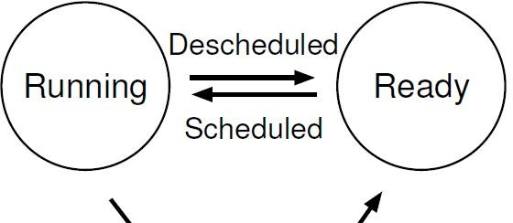
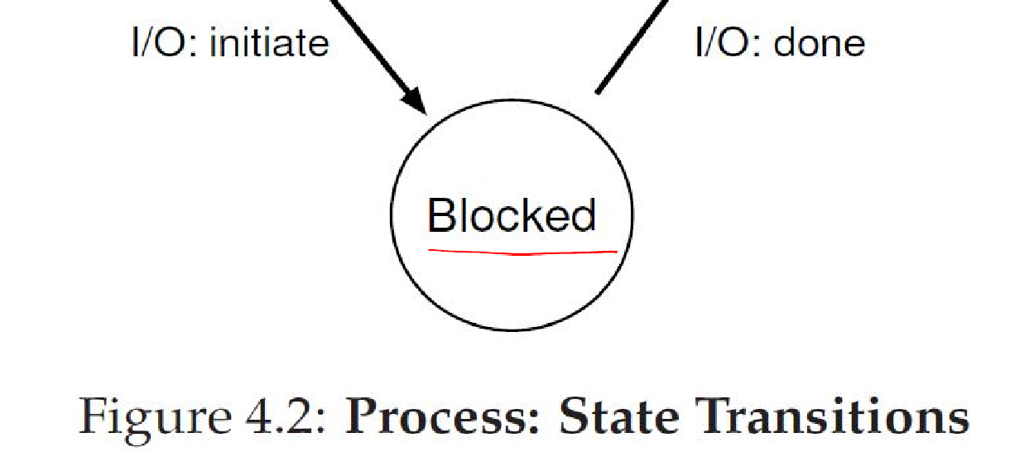
Process State Transitions

Slide 7
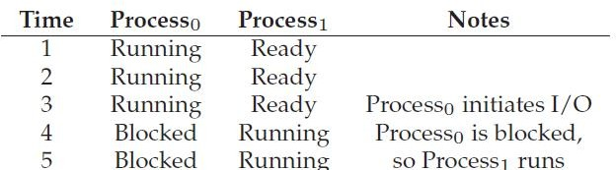
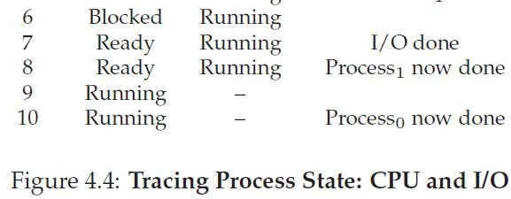
Example: Process States

Slide 8
OS data structures
OS maintains a data structure (e.g., list) of all active processes
Information about each process is stored in a process control block (PCB)
Process identifier
Process state
Pointers to other related processes (parent)
CPU context of the process (saved when the process is suspended)
Pointers to memory locations
Pointers to open files

